Slide 1
Module 7: Storage
AWS Academy Cloud Foundations
Notes:
Welcome to Module 7: Storage.

Slide 2

Module overview
Topics
Amazon Elastic Block Store (Amazon EBS)
Amazon Simple Storage Service (Amazon S3)
Amazon Elastic File System (Amazon EFS)
Amazon Simple Storage Service Glacier
Demos
Amazon EBS console
Amazon S3 console
Amazon EFS console
Amazon S3 Glacier console
Lab
Working with Amazon EBS
Activities
Storage solution case study
Knowledge check
Notes:
Cloud storage is typically more reliable, scalable, and secure than traditional on-premises storage systems. Cloud storage is a critical component of cloud computing because it holds the information that applications use. Big data analytics, data warehouses, the Internet of Things (IoT), databases, and backup and archive applications all rely on some form of data storage architecture.
This module addresses the following topics:
Amazon Elastic Block Store (Amazon EBS)
Amazon Simple Storage Service (Amazon S3)
Amazon Elastic File System (Amazon EFS)
Amazon Simple Storage Service Glacier
This module includes four recorded demonstrations that show you how to use the AWS Management Console to create storage solutions.
This module includes a hands-on lab where you create an Amazon EBS volume, and then attach it to an Amazon Elastic Compute Cloud (Amazon EC2) instance. You also create a snapshot of your volume and then use the snapshot to create a new volume.
This module includes an activity that challenges you to determine the best storage solution for a business case.
Finally, you are asked to complete a knowledge check that tests your understanding of the key concepts in this module.

Slide 3
Module objectives
After completing this module, you should be able to:
Identify the different types of storage
Explain Amazon S3
Identify the functionality in Amazon S3
Explain Amazon EBS
Identify the functionality in Amazon EBS
Perform functions in Amazon EBS to build an Amazon EC2 storage solution
Explain Amazon EFS
Identify the functionality in Amazon EFS
Explain Amazon S3 Glacier
Identify the functionality in Amazon S3 Glacier
Differentiate between Amazon EBS, Amazon S3, Amazon EFS, and Amazon S3 Glacier
Notes:
The goal of this module is to discover key concepts that relate to storage. You will learn about the different types of storage resources that are available and review the different pricing options so that you can understand how different choices affect your solution cost.
After completing this module, you should be able to:
Identify the different types of storage
Explain Amazon S3
Identify the functionality in Amazon S3
Explain Amazon EBS
Identify the functionality in Amazon EBS
Perform functions in Amazon EBS to build an Amazon EC2 storage solution
Explain Amazon EFS
Identify the functionality in Amazon EFS
Explain Amazon S3 Glacier
Identify the functionality in Amazon S3 Glacier
Differentiate between Amazon EBS, Amazon S3, Amazon EFS, and Amazon S3 Glacier

Slide 4






Core AWS services
Amazon S3
Amazon EBS
Amazon
EFS
Amazon S3 Glacier
Amazon Relational
Database Service
Amazon DynamoDB
Storage
Database
Notes:
Storage is another AWS core service category. Some broad categories of storage include: instance store (ephemeral storage), Amazon EBS, Amazon EFS, Amazon S3, and Amazon S3 Glacier.
Instance store, or ephemeral storage, is temporary storage that is added to your Amazon EC2 instance.
Amazon EBS is persistent, mountable storage that can be mounted as a device to an Amazon EC2 instance. Amazon EBS can be mounted to an Amazon EC2 instance only within the same Availability Zone. Only one Amazon EC2 instance at a time can mount an Amazon EBS volume.
Amazon EFS is a shared file system that multiple Amazon EC2 instances can mount at the same time.
Amazon S3 is persistent storage where each file becomes an object and is available through a Uniform Resource Locator (URL); it can be accessed from anywhere.
Amazon S3 Glacier is for cold storage for data that is not accessed frequently (for example, when you need long-term data storage for archival or compliance reasons).

Slide 5
Section 1: Amazon Elastic Block Store (Amazon EBS)
Module 7: Storage
Notes:
Introduce Section 1: Amazon Elastic Block Store (Amazon EBS).

Slide 6
Storage
Amazon Elastic Block Store (Amazon EBS)
Notes:
Amazon EBS provides persistent block storage volumes for use with Amazon EC2 instances. Persistent storage is any data storage device that retains data after power to that device is shut off. It is also sometimes called non-volatile storage.
Each Amazon EBS volume is automatically replicated within its Availability Zone to protect you from component failure. It is designed for high availability and durability. Amazon EBS volumes provide the consistent and low-latency performance that is needed to run your workloads.
With Amazon EBS, you can scale your usage up or down within minutes, while paying a low price for only what you provision.

Slide 7

AWS storage options: Block storage versus object storage
What if you want to change one character in a 1-GB file?
Block storage
Object storage
Change one block (piece of the file)
that contains the character
Entire file must be updated
Notes:
What happens if you want to change one character in a 1-GB file? With block storage, you change only the block that contains the character. With object storage, the entire file must be updated.
One critical difference between some storage types is whether they offer block-level storage or object-level storage.
This difference has a major effect on the throughput, latency, and cost of your storage solution. Block storage solutions are typically faster and use less bandwidth, but they can cost more than object-level storage.

Slide 8
Amazon EBS
Amazon EBS enables you to create individual storage volumes and attach them to an Amazon EC2 instance:
Amazon EBS offers block-level storage.
Volumes are automatically replicated within its Availability Zone.
It can be backed up automatically to Amazon S3 through snapshots.
Uses include –
Boot volumes and storage for Amazon Elastic Compute Cloud (Amazon EC2) instances
Data storage with a file system
Database hosts
Enterprise applications
Notes:
Amazon EBS enables you to create individual storage volumes and attach them to an Amazon EC2 instance. Amazon EBS offers block-level storage, where its volumes are automatically replicated within its Availability Zone. Amazon EBS is designed to provide durable, detachable, block-level storage (which is like an external hard drive) for your Amazon EC2 instances. Because they are directly attached to the instances, they can provide low latency between where the data is stored and where it might be used on the instance.
For this reason, they can be used to run a database with an Amazon EC2 instance. Amazon EBS volumes are included as part of the backup of your instances into Amazon Machine Images (or AMIs). AMIs are stored in Amazon S3 and can be reused to create new Amazon EC2 instances later.
A backup of an Amazon EBS volume is called a snapshot. The first snapshot is called the baseline snapshot. Any other snapshot after the baseline captures only what is different from the previous snapshot.
Amazon EBS volumes uses include:
Boot volumes and storage for Amazon EC2 instances
Data storage with a file system
Database hosts
Enterprise applications

Slide 9
Amazon EBS volume types
 | Solid State Drives (SSD) |  | Hard Disk Drives (HDD)
 | General Purpose | Provisioned IOPS | Throughput-Optimized | Cold
Maximum Volume Size | 16 TiB | 16 TiB | 16 TiB | 16 TiB
Maximum IOPS/Volume | 16,000 | 64,000 | 500 | 250
Maximum Throughput/Volume | 250 MiB/s | 1,000 MiB/s | 500 MiB/s | 250 MiB/s
Notes:
Matching the correct technology to your workload is a best practice for reducing storage costs. Provisioned IOPS SSD-backed Amazon EBS volumes can give you the highest performance. However, if your application doesn't require or won't use performance that high, General Purpose SSD is usually sufficient. Only SSDs can be used as boot volumes for EC2 instances. The lower-cost options might be a solution for additional storage or use cases other than boot volumes.
To learn more about Amazon EBS volume types, see https://docs.aws.amazon.com/AWSEC2/latest/UserGuide/ebs-volume-types.html.

Slide 10
Amazon EBS volume type use cases
Solid State Drives (SSD) |  | Hard Disk Drives (HDD)
General Purpose | Provisioned IOPS | Throughput-Optimized | Cold
This type is recommended for most workloads | Critical business applications that require sustained IOPS performance, or more than 16,000 IOPS or 250 MiB/second of throughput per volume | Streaming workloads that require consistent, fast throughput at a low price | Throughput-oriented storage for large volumes of data that is infrequently accessed
System boot volumes | Large database workloads | Big data | Scenarios where the lowest storage cost is important
Virtual desktops |  | Data warehouses | It cannot be a boot volume
Low-latency interactive applications |  | Log processing
Development and test environments |  | It cannot be a boot volume
Notes:
As mentioned previously an Amazon EBS volume is a durable, block-level storage device that you can attach to a single EC2 instance. You can use Amazon EBS volumes as primary storage for data that requires frequent updates, such as the system drive for an instance or storage for a database application. You can also use them for throughput-intensive applications that perform continuous disk scans. Amazon EBS volumes persist independently from the running life of an EC2 instance.
Use cases for EBS vary by the storage type used and whether you are using General Purpose or Provisioned IOPS.

Slide 11



Amazon EBS features
Snapshots –
Point-in-time snapshots
Recreate a new volume at any time
Encryption –
Encrypted Amazon EBS volumes
No additional cost
Elasticity –
Increase capacity
Change to different types
Notes:
To provide an even higher level of data durability, Amazon EBS enables you to create point-in-time snapshots of your volumes, and you can re-create a new volume from a snapshot at any time. You can also share snapshots or even copy snapshots to different AWS Regions for even greater disaster recovery (DR) protection. For example, you can encrypt and share your snapshots from Virginia in the US to Tokyo, Japan.
You can also have encrypted Amazon EBS volumes at no additional cost, so the data that moves between the EC2 instance and the EBS volume inside AWS data centers is encrypted in transit.
As your company grows, the amount of data that is stored on your Amazon EBS volumes is also likely to grow. Amazon EBS volumes can increase capacity and change to different types, so you can change from hard disk drives (HDDs) to solid state drives (SSDs) or increase from a 50-GB volume to a 16-TB volume. For example, you can do this resize operation dynamically without needing to stop the instances.

Slide 12
Section 2: Amazon Simple Storage Service (Amazon S3)
Module 7: Storage
Notes:
Introduce Section 3: Amazon Simple Storage Service.
Companies need the ability to simply and securely collect, store, and analyze their data on a massive scale. Amazon S3 is object storage that is built to store and retrieve any amount of data from anywhere: websites and mobile apps, corporate applications, and data from Internet of Things (IoT) sensors or devices.

Slide 13
Storage 1
Storage
Amazon Simple Storage Service (Amazon S3)
Notes:
Amazon S3 is object-level storage, which means that if you want to change a part of a file, you must make the change and then re-upload the entire modified file. Amazon S3 stores data as objects within resources that are called buckets.
You will now learn more about Amazon S3.

Slide 14


Amazon S3 overview
Data is stored as objects in buckets
Virtually unlimited storage
Single object is limited to 5 TB
Designed for 11 9s of durability
Granular access to bucket and objects
Notes:
Amazon S3 is a managed cloud storage solution that is designed to scale seamlessly and provide 11 9s of durability. You can store virtually as many objects as you want in a bucket, and you can write, read, and delete objects in your bucket. Bucket names are universal and must be unique across all existing bucket names in Amazon S3. Objects can be up to 5 TB in size. By default, data in Amazon S3 is stored redundantly across multiple facilities and multiple devices in each facility.
The data that you store in Amazon S3 is not associated with any particular server, and you do not need manage any infrastructure yourself. You can put as many objects into Amazon S3 as you want. Amazon S3 holds trillions of objects and regularly peaks at millions of requests per second.
Objects can be almost any data file, such as images, videos, or server logs. Because Amazon S3 supports objects as large as several terabytes in size, you can even store database snapshots as objects. Amazon S3 also provides low-latency access to the data over the internet by Hypertext Transfer Protocol (HTTP) or Secure HTTP (HTTPS), so you can retrieve data anytime from anywhere. You can also access Amazon S3 privately through a virtual private cloud (VPC) endpoint. You get fine-grained control over who can access your data by using AWS Identity and Access Management (IAM) policies, Amazon S3 bucket policies, and even per-object access control lists.
By default, none of your data is shared publicly. You can also encrypt your data in transit and choose to enable server-side encryption on your objects.
You can access Amazon S3 through the web-based AWS Management Console; programmatically through the API and SDKs; or with third-party solutions, which use the API or the SDKs.
Amazon S3 includes event notifications that enable you to set up automatic notifications when certain events occur, such as when an object is uploaded to a bucket or deleted from a specific bucket. Those notifications can be sent to you, or they can be used to trigger other processes, such as AWS Lambda functions.
With storage class analysis, you can analyze storage access patterns and transition the right data to the right storage class. The Amazon S3 Analytics feature automatically identifies the optimal lifecycle policy to transition less frequently accessed storage to Amazon S3 Standard – Infrequent Access (Amazon S3 Standard-IA). You can configure a storage class analysis policy to monitor an entire bucket, a prefix, or an object tag.
When an infrequent access pattern is observed, you can easily create a new lifecycle age policy that is based on the results. Storage class analysis also provides daily visualizations of your storage usage in the AWS Management Console. You can export them to an Amazon S3 bucket to analyze by using the business intelligence (BI) tools of your choice, such as Amazon QuickSight.

Slide 15
Amazon S3 storage classes
Amazon S3 offers a range of object-level storage classes that are designed for different use cases:
Amazon S3 Standard
Amazon S3 Intelligent-Tiering
Amazon S3 Standard-Infrequent Access (Amazon S3 Standard-IA)
Amazon S3 One Zone-Infrequent Access (Amazon S3 One Zone-IA)
Amazon S3 Glacier
Amazon S3 Glacier Deep Archive
Notes:
Amazon S3 offers a range of object-level storage classes that are designed for different use cases. These classes include:
Amazon S3 Standard – Amazon S3 Standard is designed for high durability, availability, and performance object storage for frequently accessed data. Because it delivers low latency and high throughput, Amazon S3 Standard is appropriate for a variety of use cases, including cloud applications, dynamic websites, content distribution, mobile and gaming applications, and big data analytics.
Amazon S3 Intelligent-Tiering – The Amazon S3 Intelligent-Tiering storage class is designed to optimize costs by automatically moving data to the most cost-effective access tier, without performance impact or operational overhead. For a small monthly monitoring and automation fee per object, Amazon S3 monitors access patterns of the objects in Amazon S3 Intelligent-Tiering, and moves the objects that have not been accessed for 30 consecutive days to the infrequent access tier. If an object in the infrequent access tier is accessed, it is automatically moved back to the frequent access tier. There are no retrieval fees when you use the Amazon S3 Intelligent-Tiering storage class, and no additional fees when objects are moved between access tiers. It works well for long-lived data with access patterns that are unknown or unpredictable.
Amazon S3 Standard-Infrequent Access (Amazon S3 Standard-IA) – The Amazon S3 Standard-IA storage class is used for data that is accessed less frequently, but requires rapid access when needed. Amazon S3 Standard-IA is designed to provide the high durability, high throughput, and low latency of Amazon S3 Standard, with a low per-GB storage price and per-GB retrieval fee. This combination of low cost and high performance makes Amazon S3 Standard-IA good for long-term storage and backups, and as a data store for disaster recovery files.
Amazon S3 One Zone-Infrequent Access (Amazon S3 One Zone-IA) – Amazon S3 One Zone-IA is for data that is accessed less frequently, but requires rapid access when needed. Unlike other Amazon S3 storage classes, which store data in a minimum of three Availability Zones, Amazon S3 One Zone-IA stores data in a single Availability Zone and it costs less than Amazon S3 Standard-IA. Amazon S3 One Zone-IA works well for customers who want a lower-cost option for infrequently accessed data, but do not require the availability and resilience of Amazon S3 Standard or Amazon S3 Standard-IA. It is a good choice for storing secondary backup copies of on-premises data or easily re-creatable data. You can also use it as cost-effective storage for data that is replicated from another AWS Region by using Amazon S3 Cross-Region Replication.
Amazon S3 Glacier – Amazon S3 Glacier is a secure, durable, and low-cost storage class for data archiving. You can reliably store any amount of data at costs that are competitive with—or cheaper than—on-premises solutions. To keep costs low yet suitable for varying needs, Amazon S3 Glacier provides three retrieval options that range from a few minutes to hours. You can upload objects directly to Amazon S3 Glacier, or use Amazon S3 lifecycle policies to transfer data between any of the Amazon S3 storage classes for active data (Amazon S3 Standard, Amazon S3 Intelligent-Tiering, Amazon S3 Standard-IA, and Amazon S3 One Zone-IA) and Amazon S3 Glacier.
Amazon S3 Glacier Deep Archive – Amazon S3 Glacier Deep Archive is the lowest-cost storage class for Amazon S3. It supports long-term retention and digital preservation for data that might be accessed once or twice in a year. It is designed for customers — particularly customers in highly regulated industries, such as financial services, healthcare, and public sectors — that retain datasets for 7–10 years (or more) to meet regulatory compliance requirements. Amazon S3 Glacier Deep Archive can also be used for backup and disaster recovery use cases. It is a cost-effective and easy-to-manage alternative to magnetic tape systems, whether these tape systems are on-premises libraries or off-premises services. Amazon S3 Glacier Deep Archive complements Amazon S3 Glacier, and it is also designed to provide 11 9s of durability. All objects that are stored in Amazon S3 Glacier Deep Archive are replicated and stored across at least three geographically dispersed Availability Zones, and these objects can be restored within 12 hours.
For more information about Amazon S3 storage classes, see https://docs.aws.amazon.com/AmazonS3/latest/dev/storage-class-intro.html.

Slide 16


Amazon S3 bucket URLs (two styles)
To upload your data:
Create a bucket in an AWS Region.
Upload almost any number of objects to the bucket.
Amazon S3
Bucket path-style URL endpoint:
[bucket name]
https://s3.ap-northeast-1.amazonaws.com/bucket-name
Region code
Bucket name
Bucket virtual hosted-style URL endpoint:
Preview2.mp4
https:// bucket-name.s3-ap-northeast-1.amazonaws.com
Tokyo Region (ap-northeast-1)
Bucket name
Region code
Notes:
To use Amazon S3 effectively, you must understand a few simple concepts. First, Amazon S3 stores data inside buckets. Buckets are essentially the prefix for a set of files, and must be uniquely named across all of Amazon S3 globally. Buckets are logical containers for objects. You can have one or more buckets in your account. You can control access for each bucket—who can create, delete, and list objects in the bucket. You can also view access logs for the bucket and its objects, and choose the geographical region where Amazon S3 stores the bucket and its contents.
To upload your data (such as photos, videos, or documents), create a bucket in an AWS Region, and then upload almost any number of objects to the bucket.
In the example, Amazon S3 was used to create a bucket in the Tokyo Region, which is identified within AWS formally by its Region code: ap-northeast-1
The URL for a bucket is structured like the examples. You can use two different URL styles to refer to buckets.
Amazon S3 refers to files as objects. As soon as you have a bucket, you can store almost any number of objects inside it. An object is composed of data and any metadata that describes that file, including a URL. To store an object in Amazon S3, you upload the file that you want to store to a bucket.
When you upload a file, you can set permissions on the data and any metadata.
In this example, the object Preview2.mp4 is stored inside the bucket. The URL for the file includes the object name at the end.

Slide 17


Data is redundantly stored in the Region
media/welcome.mp4
Facility 1
Facility 2
Facility 3
my-bucket-name
Region
Notes:
When you create a bucket in Amazon S3, it is associated with a specific AWS Region. When you store data in the bucket, it is redundantly stored across multiple AWS facilities within your selected Region.
Amazon S3 is designed to durably store your data, even if there is concurrent data loss in two AWS facilities.

Slide 18

Designed for seamless scaling
media/welcome.mp4
prod2.mp4
prod3.mp4
prod4.mp4
prod5.mp4
prod6.mp4
prod7.mp4
prod8.mp4
my-bucket-name
prod9.mp4
prod10.mp4
prod11.mp4
prod12.mp4
Notes:
Amazon S3 automatically manages the storage behind your bucket while your data grows. You can get started immediately, and your data storage will grow with your application needs.
Amazon S3 also scales to handle a high volume of requests. You do not need to provision the storage or throughput, and you are billed only for what you use.

Slide 19



Access the data anywhere
AWS Management Console
AWS Command Line Interface
SDK
Notes:
You can access Amazon S3 through the console, AWS Command Line Interface (AWS CLI), or AWS SDK. You can also access the data in your bucket directly by using REST-based endpoints.
The endpoints support HTTP or HTTPS access. To support this type of URL-based access, Amazon S3 bucket names must be globally unique and Domain Name Server (DNS)-compliant.
Also, object keys should use characters that are safe for URLs.

Slide 20
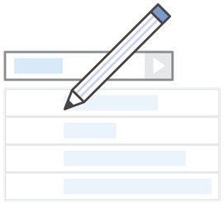
Common use cases
Storing application assets
Static web hosting
Backup and disaster recovery (DR)
Staging area for big data
Many more….
Notes:
This flexibility to store a virtually unlimited amount of data—and to access that data from anywhere—means that Amazon S3 is suitable for a variety of scenarios. You will now consider some use cases for Amazon S3:
As a location for any application data, Amazon S3 buckets provide a shared location for storing objects that any instances of your application can access—including applications on Amazon EC2 or even traditional servers. This feature can be useful for user-generated media files, server logs, or other files that your application must store in a common location. Also, because the content can be fetched directly over the internet, you can offload serving that content from your application and enable clients to directly fetch the data from Amazon S3 themselves.
For static web hosting, Amazon S3 buckets can serve the static contents of your website, including HTML, CSS, JavaScript, and other files.
The high durability of Amazon S3 makes it a good candidate for storing backups of your data. For greater availability and disaster recovery capability, Amazon S3 can even be configured to support cross-Region replication so that data in an Amazon S3 bucket in one Region can be automatically replicated to another Amazon S3 Region.

Slide 21


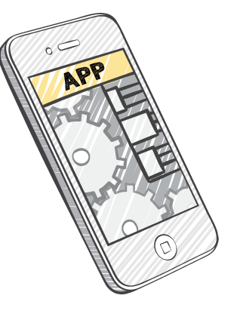


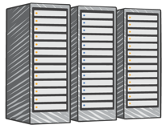
Amazon S3 common scenarios
Backup and storage
Application hosting
Media hosting
Software delivery
Amazon S3 buckets
Corporate data center
Amazon EC2 instances
Notes:
Backup and storage – Provide data backup and storage services for others
Application hosting – Provide services that deploy, install, and manage web applications
Media hosting – Build a redundant, scalable, and highly available infrastructure that hosts video, photo, or music uploads and downloads
Software delivery – Host your software applications that customers can download

Slide 22
Amazon S3 pricing
Pay only for what you use, including –
GBs per month
Transfer OUT to other Regions
PUT, COPY, POST, LIST, and GET requests
You do not pay for –
Transfers IN to Amazon S3
Transfers OUT from Amazon S3 to Amazon CloudFront or Amazon EC2 in the same Region
Notes:
With Amazon S3, specific costs vary depending on the Region and the specific requests that were made. You pay only for what you use, including gigabytes per month; transfer out of other Regions; and PUT, COPY, POST, LIST, and GET requests. As a general rule, you pay only for transfers that cross the boundary of your Region, which means you do not pay for transfers in to Amazon S3 or transfers out from Amazon S3 to Amazon CloudFront edge locations within that same Region.

Slide 23
Amazon S3: Storage pricing (1 of 2)
To estimate Amazon S3 costs, consider the following:
Storage class type –
Standard storage is designed for:
11 9s of durability
Four 9s of availability
S3 Standard-Infrequent Access (S-IA) is designed for:
11 9s of durability
Three 9s of availability
Amount of storage –
The number and size of objects
Notes:
When you begin to estimate the costs of Amazon S3, you must consider the following:
Storage class type –
Standard storage is designed to provide 11 9s of durability and four 9s of availability.
S3 Standard – Infrequent Access (S-IA) is a storage option within Amazon S3 that you can use to reduce your costs by storing less frequently accessed data at slightly lower levels of redundancy than Amazon S3 standard storage. Standard – Infrequent Access is designed to provide the same 11 9s of durability as Amazon S3, with three 9s of availability in a given year. Each class has different rates.
Amount of storage – The number and size of objects stored in your Amazon S3 buckets.

Slide 24
Amazon S3: Storage pricing (2 of 2)
Requests –
The number and type of requests (GET, PUT, COPY)
Type of requests:
Different rates for GET requests than other requests.
Data transfer –
Pricing is based on the amount of data that is transferred out of the Amazon S3 Region
Data transfer in is free, but you incur charges for data that is transferred out.
Notes:
Requests – Consider the number and type of requests. GET requests incur charges at different rates than other requests, such as PUT and COPY requests.
GET – Retrieves an object from Amazon S3. You must have READ access to use this operation.
PUT – Adds an object to a bucket. You must have WRITE permissions on a bucket to add an object to it.
COPY – Creates a copy of an object that is already stored in Amazon S3. A COPY operation is the same as performing a GET and then a PUT.
Data transfer – Consider the amount of data that is transferred out of the Amazon S3 Region. Remember that data transfer in is free, but there is a charge for data transfer out.

Slide 25

Section 2 key takeaways
Amazon S3 is a fully managed cloud storage service.
You can store a virtually unlimited number of objects.
You pay for only what you use.
You can access Amazon S3 at any time from anywhere through a URL.
Amazon S3 offers rich security controls.
Notes:
You have completed an introduction to Amazon S3, including key features and some common use cases.
To learn more about Amazon S3, see https://aws.amazon.com/s3/.

Slide 26
Section 3: Amazon Elastic File System (Amazon EFS)
Module 7: Storage
Notes:
Introduce Section 3: Amazon Elastic File System (Amazon EFS)
Amazon EFS implements storage for EC2 instances that multiple virtual machines can access at the same time. It is implemented as a shared file system that uses the Network File System (NFS) protocol.

Slide 27
Storage 2
Storage
Amazon Elastic File System (Amazon EFS)
Notes:
Amazon Elastic File System (Amazon EFS) provides simple, scalable, elastic file storage for use with AWS services and on-premises resources. It offers a simple interface that enables you to create and configure file systems quickly and easily.
Amazon EFS is built to dynamically scale on demand without disrupting applications—it will grow and shrink automatically as you add and remove files. It is designed so that your applications have the storage they need, when they need it.

Slide 28
Amazon EFS features
File storage in the AWS Cloud
Works well for big data and analytics, media processing workflows, content management, web serving, and home directories
Petabyte-scale, low-latency file system
Shared storage
Elastic capacity
Supports Network File System (NFS) versions 4.0 and 4.1 (NFSv4)
Compatible with all Linux-based AMIs for Amazon EC2
Notes:
Amazon EFS is a fully managed service that makes it easy to set up and scale file storage in the AWS Cloud. You can use Amazon EFS to build a file system for big data and analytics, media processing workflows, content management, web serving, and home directories.
You can create file systems that are accessible to Amazon EC2 instances through a file system interface (using standard operating system file I/O APIs). These file systems support full file system access semantics, such as strong consistency and file locking.
Amazon EFS file systems can automatically scale from gigabytes to petabytes of data without the need to provision storage. Thousands of Amazon EC2 instances can access an Amazon EFS file system at the same time, and Amazon EFS is designed to provide consistent performance to each Amazon EC2 instance. Amazon EFS is also designed to be highly durable and highly available. Amazon EFS requires no minimum fee or setup costs, and you pay only for the storage that you use.

Slide 29


Amazon EFS architecture
VPC
Availability Zone A
Availability Zone B
Availability Zone C
Private subnet
Private subnet
Private subnet
Network Interface
Network Interface
Network Interface
Private subnet
Network Interface
Network Interface
Network Interface
Mount target
Mount target
Mount target
Elastic File System
Notes:
Amazon EFS provides file storage in the cloud. With Amazon EFS, you can create a file system, mount the file system on an Amazon EC2 instance, and then read and write data from to and from your file system. You can mount an Amazon EFS file system in your VPC, through NFS versions 4.0 and 4.1 (NFSv4).
You can access your Amazon EFS file system concurrently from Amazon EC2 instances in your VPC, so applications that scale beyond a single connection can access a file system. Amazon EC2 instances that run in multiple Availability Zones within the same AWS Region can access the file system, so many users can access and share a common data source.
In the diagram, the VPC has three Availability Zones, and each Availability Zone has one mount target that was created in it. We recommend that you access the file system from a mount target within the same Availability Zone. One of the Availability Zones has two subnets. However, a mount target is created in only one of the subnets.

Slide 30
Amazon EFS implementation
1
Create your Amazon EC2 resources and launch your Amazon EC2 instance.
Create your Amazon EFS file system.
Create your mount targets in the appropriate subnets.
Connect your Amazon EC2 instances to the mount targets.
Verify the resources and protection of your AWS account.
2
3
4
5
Notes:
You must complete five steps to create and use your first Amazon EFS file system, mount it on an Amazon EC2 instance in your VPC, and test the end-to-end setup:
Create your Amazon EC2 resources and launch your instance. (Before you can launch and connect to an Amazon EC2 instance, you must create a key pair, unless you already have one.)
Create your Amazon EFS file system.
In the appropriate subnets, create your mount targets.
Next, connect to your Amazon EC2 instance and mount the Amazon EFS file system.
Finally, clean up your resources and protect your AWS account.

Slide 31

Amazon EFS resources
File system
Mount target
Subnet ID
Security groups
One or more per file system
Create in a VPC subnet
One per Availability Zone
Must be in the same VPC
Tags
Key-value pairs
Notes:
In Amazon EFS, a file system is the primary resource. Each file system has properties such as:
ID
Creation token
Creation time
File system size in bytes
Number of mount targets that are created for the file system
File system state
Amazon EFS also supports other resources to configure the primary resource. These resources include mount targets and tags.
Mount target: To access your file system, you must create mount targets in your VPC.
Each mount target has the following properties:
The mount target ID
The subnet ID for the subnet where it was created
The file system ID for the file system where it was created
An IP address where the file system can be mounted
The mount target state
You can use the IP address or the Domain Name System (DNS) name in your mount command.
Tags: To help organize your file systems, you can assign your own metadata to each of the file systems that you create. Each tag is a key-value pair.
Think of mount targets and tags as subresources that do not exist unless they are associated with a file system.

Slide 32
Section 3 key takeaways
Amazon EFS provides file storage over a network.
Perfect for big data and analytics, media processing workflows, content management, web serving, and home directories.
Fully managed service that eliminates storage administration tasks.
Accessible from the console, an API, or the CLI.
Scales up or down as files are added or removed and you pay for what you use.
Notes:
You have completed an introduction to Amazon EFS, including key features and key resources. Amazon EFS provides file storage in the cloud that works well for big data and analytics, media processing workflows, content management, web serving, and home directories.
Amazon EFS scales up or down when files are added or removed, and you pay for only what you are using.
Amazon EFS is a fully managed service that is accessible from the console, an API, or the AWS CLI.
To learn more about Amazon EFS, see https://aws.amazon.com/efs/

Slide 33
EBS vs. EFS
Know the difference!
EBS (Elastic Block Store)
Attached to a single EC2 instance at a time
Fixed size
Single availability zone
Stores "blocks" not "files"
EFS (Elastic File Store)
Attached to multiple EC2 instances
Automatic scaling (elastic)
Multiple availability zones
Stores "files" not "blocks"
Analogy: a virtual solid state drive
Analogy: a shared network drive

Slide 34
Section 4: Amazon S3 Glacier
Module 7: Storage
Notes:
Introducing Section 4: Amazon S3 Glacier
Amazon S3 Glacier is a secure, durable, and extremely low-cost cloud storage service for data archiving and long-term backup.

Slide 35
Storage 3
Storage
Amazon S3 Glacier
Notes:
This section covers Amazon S3 Glacier.

Slide 36
Amazon S3 Glacier review
Amazon S3 Glacier is a data archiving service that is designed for security, durability, and an extremely low cost.
Amazon S3 Glacier is designed to provide 11 9s of durability for objects.
It supports the encryption of data in transit and at rest through Secure Sockets Layer (SSL) or Transport Layer Security (TLS).
The Vault Lock feature enforces compliance through a policy.
Extremely low-cost design works well for long-term archiving.
Provides three options for access to archives—expedited, standard, and bulk—retrieval times range from a few minutes to several hours.
Notes:
When you use Amazon S3 Glacier to archive data, you can store your data at an extremely low cost (even in comparison to Amazon S3), but you cannot retrieve your data immediately when you want it.
Data that is stored in Amazon S3 Glacier can take several hours to retrieve, which is why it works well for archiving.
There are three key Amazon S3 Glacier terms you should be familiar with:
Archive – Any object (such as a photo, video, file, or document) that you store in Amazon S3 Glacier. It is the base unit of storage in Amazon S3 Glacier. Each archive has its own unique ID and it can also have a description.
Vault – A container for storing archives. When you create a vault, you specify the vault name and the Region where you want to locate the vault.
Vault access policy – Determine who can and cannot access the data that is stored in the vault, and what operations users can and cannot perform. One vault access permissions policy can be created for each vault to manage access permissions for that vault. You can also use a vault lock policy to make sure that a vault cannot be altered. Each vault can have one vault access policy and one vault lock policy that are attached to it.
You have three options for retrieving data, each with varying access times and cost:
Expedited retrievals are typically made available within 1–5 minutes (highest cost).
Standard retrievals typically complete within 3–5 hours (less time than expedited, more time than bulk).
Bulk retrievals typically complete within 5–12 hours (lowest cost).
You might compare these options to choosing the cost for shipping a package by using the most economical method for your needs.

Slide 37


Amazon S3 Glacier
Storage service for low-cost data archiving and long-term backup
You can configure lifecycle archiving of Amazon S3 content to Amazon S3 Glacier
Retrieval options –
Standard: 3–5 hours
Bulk: 5–12 hours
Expedited: 1–5 minutes
Archive after 30 days
Delete after 5 years
Amazon S3 bucket
Amazon S3 Glacier Archive
Notes:
Amazon S3 Glacier's data archiving means that although you can store your data at an extremely low cost (even in comparison to Amazon S3), you cannot retrieve your data immediately when you want it.
Data stored in Amazon S3 Glacier can take several hours to retrieve.
You should be familiar with three key Amazon S3 Glacier terms:
Archive: Any object such as a photo, video, file, or document that you store in Amazon S3 Glacier. It is the base unit of storage in Amazon S3 Glacier. Each archive has its own unique ID and can also have a description.
Vault: A container for storing archives. When you create a vault, you specify the vault name and the region in which you would like to locate the vault.
Vault Access Policy: Determine who can and cannot access the data stored in the vault and what operations users can and cannot perform. One vault access policy can be created for each vault to manage access permissions for that vault. You can also use a vault lock policy to make sure a vault cannot be altered. Each vault can have one vault access policy and one vault lock policy that is attached to it.
Three options are available for retrieving data with varying access times and cost: expedited, standard, and bulk retrievals. They are listed as follows:
Expedited retrievals are typically made available within 1 – 5 minutes (highest cost).
Standard retrievals typically complete within 3 – 5 hours (less than expedited, more than bulk).
Bulk retrievals typically complete within 5 – 12 hours (lowest cost).
Compare it to choosing the cost to most economically ship a package.

Slide 38






Amazon S3 Glacier use cases
Media asset archiving
Healthcare information archiving
Regulatory and compliance archiving
Scientific data archiving
Digital preservation
Magnetic tape replacement
Notes:
Media asset archiving
Media assets—such as video and news footage—require durable storage and can grow to many petabytes over time. Amazon S3 Glacier enables you to archive older media content affordably and then move it to Amazon S3 for distribution when it is needed.
Healthcare information archiving
To meet regulatory requirements, hospital systems must retain petabytes of patient records—such as Low-Income Subsidy (LIS) information, picture archiving and communication system (PACS) data, or Electronic Health Records (EHR)—for decades. Amazon S3 Glacier can help you reliably archive patient record data securely at a very low cost.
Regulatory and compliance archiving
Many enterprises, like those in financial services and healthcare, must retain regulatory and compliance archives for extended durations. Amazon S3 Glacier Vault Lock can help you set compliance controls so you can work towards meeting your compliance objectives, such as the U.S. Securities and Exchange Commission (SEC) Rule 17a-4(f).
Scientific data archiving
Research organizations generate, analyze, and archive large amounts of data. By using Amazon S3 Glacier, you can reduce the complexities of hardware and facility management and capacity planning.
Digital preservation
Libraries and government agencies must handle data integrity challenges in their digital preservation efforts. Unlike traditional systems—which can require laborious data verification and manual repair—Amazon S3 Glacier performs regular, systematic data integrity checks, and it is designed to be automatically self-healing.
Magnetic tape replacement
On-premises or offsite tape libraries can lower storage costs, but they can require large upfront investments and specialized maintenance. Amazon S3 Glacier has no upfront cost and reduces the cost and burden of maintenance.

Slide 39
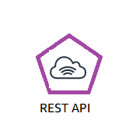

Using Amazon S3 Glacier
RESTful
web services
Java or .NET SDKs
Amazon S3 with lifecycle policies
Notes:
To store and access data in Amazon S3 Glacier, you can use the AWS Management Console. However, only a few operations—such as creating and deleting vaults, and creating and managing archive policies—are available in the console.
For almost all other operations and interactions with Amazon S3 Glacier, you must use either the Amazon S3 Glacier REST APIs, the AWS Java or .NET SDKs, or the AWS CLI.
You can also use lifecycle policies to archive data into Amazon S3 Glacier. Next, you will learn about lifecycle policies.

Slide 40


Lifecycle policies
Amazon S3 lifecycle policies enable you to delete or move objects based on age.
Amazon S3 Standard
Amazon S3 Standard - Infrequent Access
Amazon
S3 Glacier
Delete
30 days
60 days
365 days
Preview2.mp4
Preview2.mp4
Preview2.mp4
Notes:
You should automate the lifecycle of the data that you store in Amazon S3. By using lifecycle policies, you can cycle data at regular intervals between different Amazon S3 storage types. This automation reduces your overall cost, because you pay less for data as it becomes less important with time.
In addition to setting lifecycle rules per object, you can also set lifecycle rules per bucket.
Consider an example of a lifecycle policy that moves data as it ages from Amazon S3 Standard to Amazon S3 Standard – Infrequent Access, and finally, into Amazon S3 Glacier before it is deleted. Suppose that a user uploads a video to your application and your application generates a thumbnail preview of the video. This video preview is stored to Amazon S3 Standard, because it is likely that the user wants to access it right away.
Your usage data indicates that most thumbnail previews are not accessed after 30 days. Your lifecycle policy takes these previews and moves them to Amazon S3 – Infrequent Access after 30 days. After another 30 days elapse, the preview is unlikely to be accessed again. The preview is then moved to Amazon S3 Glacier, where it remains for 1 year. After 1 year, the preview is deleted. The important thing is that the lifecycle policy manages all this movement automatically.
To learn more about object lifecycle management, see http://docs.aws.amazon.com/AmazonS3/latest/dev/object-lifecycle-mgmt.html

Slide 41
Storage comparison
 | Amazon S3 | Amazon S3 Glacier
Data Volume | No limit | No limit
Average Latency | ms | minutes/hours
Item Size | 5 TB maximum | 40 TB maximum
Cost/GB per Month | Higher cost | Lower cost
Billed Requests | PUT, COPY, POST, LIST, and GET | UPLOAD and retrieval
Retrieval Pricing | ¢ Per request | ¢¢ Per request and per GB
Notes:
While Amazon S3 and Amazon S3 Glacier are both object storage solutions that enable you to store a virtually unlimited amount of data, they have some critical differences between them. The chart outlines some of these differences.
Be careful when you decide which storage solution is correct for your needs. These two services serve very different storage needs. Amazon S3 is designed for frequent, low-latency access to your data, but Amazon S3 Glacier is designed for low-cost, long-term storage of infrequently accessed data.
The maximum item size in Amazon S3 is 5 TB, but Amazon S3 Glacier can store items that are up to 40 TB.
Because Amazon S3 gives you faster access to your data, the storage cost per gigabyte is higher than it is with Amazon S3 Glacier.
While both services have per-request charges, Amazon S3 charges for PUT, COPY, POST, LIST, GET operations. In contrast, Amazon S3 Glacier charges for UPLOAD and retrieval operations.
Because Amazon S3 Glacier was designed for less-frequent access to data, it costs more for each retrieval request than Amazon S3.

Slide 42
Section 4 key takeaways
Amazon S3 Glacier is a data archiving service that is designed for security, durability, and an extremely low cost.
Amazon S3 Glacier pricing is based on Region.
Its extremely low-cost design works well for long-term archiving.
The service is designed to provide 11 9s of durability for objects.
Notes:
You have completed an introduction to Amazon S3 Glacier, which included key differences between Amazon S3 and Amazon S3 Glacier.
To learn more about Amazon S3 Glacier, see Glacier.

Slide 43
Module wrap-up
Module 7: Storage
Notes:
It’s now time to review the module, and wrap up with a knowledge check and a discussion of a practice certification exam question.

Slide 44
Module summary
In summary, in this module, you learned how to:
Identify the different types of storage
Explain Amazon S3
Identify the functionality in Amazon S3
Explain Amazon EBS
Identify the functionality in Amazon EBS
Perform functions in Amazon EBS to build an Amazon EC2 storage solution
Explain Amazon EFS
Identify the functionality in Amazon EFS
Explain Amazon S3 Glacier
Identify the functionality in Amazon S3 Glacier
Differentiate between Amazon EBS, Amazon S3, Amazon EFS, and Amazon S3 Glacier
Notes:
In summary, in this module, you learned how to:
Identify the different types of storage
Explain Amazon S3
Identify the functionality in Amazon S3
Explain Amazon EBS
Identify the functionality in Amazon EBS
Perform functions in Amazon EBS to build an Amazon EC2 storage solution
Explain Amazon EFS
Identify the functionality in Amazon EFS
Explain Amazon S3 Glacier
Identify the functionality in Amazon S3 Glacier
Differentiate between Amazon EBS, Amazon S3, Amazon EFS, and Amazon S3 Glacier

Slide 45
Module 8: Databases
AWS Academy Cloud Foundations
Notes:
Welcome to Module 8: Databases

Slide 46
Module overview
Topics
Amazon Relational Database Service (Amazon RDS)
Amazon DynamoDB
Amazon Redshift
Amazon Aurora
Demos
Amazon RDS console
Amazon DynamoDB console
Lab
Lab 5: Build Your DB Server and Interact with Your DB Using an App
Activity
Database case studies
Knowledge check
Notes:
The business world is constantly changing and evolving. By accurately recording, updating, and tracking data on an efficient and regular basis, companies can use the immense potential from the insights that they obtain from their data. Database management systems are the crucial link for managing this data. Like other cloud services, cloud databases offer significant cost advantages over traditional database strategies.
In this module, you will learn about Amazon Relational Database Service (or Amazon RDS), Amazon DynamoDB, Amazon Redshift, and Amazon Aurora.
This module will address the following topics:
Amazon Relational Database Service (Amazon RDS)
Amazon DynamoDB
Amazon Redshift
Amazon Aurora
The module includes two recorded demonstrations that will show you how to access and interact with Amazon RDS and Amazon DynamoDB by using the AWS Management Console.
The module also includes a hands-on lab where you will set up an Amazon RDS database solution.
The module also includes an activity that challenges you to select the appropriate database service for a business case.
Finally, you will be asked to complete a knowledge check that will test your understanding of the key concepts that are covered in this module.

Slide 47
Module objectives
After completing this module, you should be able to:
Explain Amazon Relational Database Service (Amazon RDS)
Identify the functionality in Amazon RDS
Explain Amazon DynamoDB
Identify the functionality in Amazon DynamoDB
Explain Amazon Redshift
Explain Amazon Aurora
Perform tasks in an RDS database, such as launching, configuring, and interacting
Notes:
In this module, you will learn about key concepts that are related to database solutions, including:
Understanding the different database services in the cloud.
Discovering the differences between unmanaged and managed database solutions.
Understanding the differences between Structured Query Language (or SQL) and NoSQL databases.
Comparing the availability differences of alternative database solutions.
The goal of this module is to help you understand the database resources that are available to power your solution. You will also review the different service features that are available, so you can begin to understand how different choices impact things like solution availability
After completing this module, you should be able to:
Explain Amazon Relational Database Service (Amazon RDS)
Identify the functionality in Amazon RDS
Explain Amazon DynamoDB
Identify the functionality in Amazon DynamoDB
Explain Amazon Redshift
Explain Amazon Aurora
Perform tasks in an RDS database, such as launching, configuring, and interacting

Slide 48
Section 1: Amazon Relational Database Service
Module 8: Databases
Notes:
Introducing Section 1: Amazon Relational Database Service.

Slide 49
Amazon Relational Database Service
Amazon Relational Database Service (Amazon RDS)
Notes:
Welcome to an introduction to the foundational database services that are available on Amazon Web Services (AWS). This module begins with Amazon Relational Database Service (Amazon RDS).
This section starts by reviewing the differences between a managed and unmanaged service in relation to Amazon RDS.

Slide 50



Unmanaged versus managed services
Unmanaged:
Managed:
Scaling, fault tolerance, and availability are managed by you.
Scaling, fault tolerance, and availability are typically built into the service.
Notes:
AWS solutions typically fall into one of two categories: unmanaged or managed.
Unmanaged services are typically provisioned in discrete portions as specified by the user. You must manage how the service responds to changes in load, errors, and situations where resources become unavailable. Say that you launch a web server on an Amazon Elastic Compute Cloud (Amazon EC2) instance. Because Amazon EC2 is an unmanaged solution, that web server will not scale to handle increased traffic load or replace unhealthy instances with healthy ones unless you specify that it use a scaling solution, such as AWS Automatic Scaling. The benefit to using an unmanaged service is that you have more fine-tuned control over how your solution handles changes in load, errors, and situations where resources become unavailable.
Managed services require the user to configure them. For example, you create an Amazon Simple Storage Service (Amazon S3) bucket and then set permissions for it. However, managed services typically require less configuration. Say that you have a static website that you host in a cloud-based storage solution, such as Amazon S3. The static website does not have a web server. However, because Amazon S3 is a managed solution, features such as scaling, fault-tolerance, and availability would be handled automatically and internally by Amazon S3.
Now, you will look at the challenges of running an unmanaged, standalone relational database. Then, you will learn how Amazon RDS addresses these challenges.

Slide 51
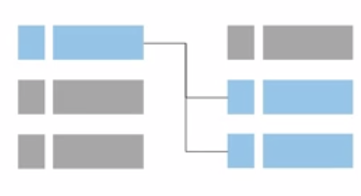
Challenges of relational databases
Server maintenance and energy footprint
Software installation and patches
Database backups and high availability
Limits on scalability
Data security
Operating system (OS) installation and patches
Notes:
When you run your own relational database, you are responsible for several administrative tasks, such as server maintenance and energy footprint, software, installation and patching, and database backups. You are also responsible for ensuring high availability, planning for scalability, data security, and operating system (OS) installation and patching. All these tasks take resources from other items on your to-do list, and require expertise in several areas.

Slide 52


Amazon RDS
Managed service that sets up and operates a relational database in the cloud.
AWS Cloud
Users
Application
Servers
Amazon RDS
Notes:
Amazon RDS is a managed service that sets up and operates a relational database in the cloud.
To address the challenges of running an unmanaged, standalone relational database, AWS provides a service that sets up, operates, and scales the relational database without any ongoing administration. Amazon RDS provides cost-efficient and resizable capacity, while automating time-consuming administrative tasks.
Amazon RDS enables you to focus on your application, so you can give applications the performance, high availability, security, and compatibility that they need. With Amazon RDS, your primary focus is your data and optimizing your application.

Slide 53

From on-premises databases to Amazon RDS
Database in Amazon Elastic Compute Cloud (Amazon EC2)
Database in Amazon RDS or Amazon Aurora
On-premises database
Application optimization
Scaling
High Availability
Database backups
Database software patches
Database software installs
Operation system patches
Operating system install
Server maintenance
Rack and stack servers
Power, HVAC, network
Application optimization
Scaling
High Availability
Database backups
Database software patches
Database software installs
Operation system patches
Operating system install
Server maintenance
Rack and stack servers
Power, HVAC, network
Application optimization
Scaling
High Availability
Database backups
Database software patches
Database software installs
Operation system patches
Operating system install
Server maintenance
Rack and stack servers
Power, HVAC, network
AWS
provides
AWS
provides
Notes:
What does the term managed services mean?
When your database is on premises, the database administrator is responsible for everything. Database administration tasks include optimizing applications and queries; setting up the hardware; patching the hardware; setting up networking and power; and managing heating, ventilation, and air conditioning (HVAC).
If you move to a database that runs on an Amazon Elastic Compute Cloud (Amazon EC2) instance, you no longer need to manage the underlying hardware or handle data center operations. However, you are still responsible for patching the OS and handling all software and backup operations.
If you set up your database on Amazon RDS or Amazon Aurora, you reduce your administrative responsibilities. By moving to the cloud, you can automatically scale your database, enable high availability, manage backups, and perform patching. Thus, you can focus on what really matters most—optimizing your application.

Slide 54

Managed services responsibilities
You manage:
Application optimization
AWS manages:
OS installation and patches
Database software installation and patches
Database backups
High availability
Scaling
Power and racking and stacking servers
Server maintenance
Amazon RDS
Notes:
With Amazon RDS, you manage your application optimization. AWS manages installing and patching the operating system, installing and patching the database software, automatic backups, and high availability.
AWS also scales resources, manages power and servers, and performs maintenance.
Offloading these operations to the managed Amazon RDS service reduces your operational workload and the costs that are associated with your relational database. You will now go through a brief overview of the service and a few potential use cases.

Slide 55
Amazon RDS DB instances
Amazon RDS
=
MySQL
DB Instance Class
CPU
Memory
Network performance
DB Instance Storage
Magnetic
General Purpose (solid state drive, or SSD)
Provisioned IOPS
Amazon Aurora
M
Microsoft SQL Server
PostgreSQL
Amazon RDS DB main instance
MariaDB
Oracle
DB engines
Notes:
The basic building block of Amazon RDS is the database instance. A database instance is an isolated database environment that can contain multiple user-created databases. It can be accessed by using the same tools and applications that you use with a standalone database instance. The resources in a database instance are determined by its database instance class, and the type of storage is dictated by the type of disks.
Database instances and storage differ in performance characteristics and price, which enable you to customize your performance and cost to the needs of your database. When you choose to create a database instance, you must first specify which database engine to run. Amazon RDS currently supports six databases: MySQL, Amazon Aurora, Microsoft SQL Server, PostgreSQL, MariaDB, and Oracle.

Slide 56





Amazon RDS in a virtual private cloud (VPC)
AWS Cloud
Availability Zone
VPC
Public subnet
Internet gateway
Users
Amazon EC2
Private subnet
Amazon RDS
Notes:
You can run an instance by using Amazon Virtual Private Cloud (Amazon VPC). When you use a virtual private cloud (VPC), you have control over your virtual networking environment.
You can select your own IP address range, create subnets, and configure routing and access control lists (ACLs). The basic functionality of Amazon RDS is the same whether or not it runs in a VPC. Usually, the database instance is isolated in a private subnet and is only made directly accessible to indicated application instances. Subnets in a VPC are associated with a single Availability Zone, so when you select the subnet, you are also choosing the Availability Zone (or physical location) for your database instance.

Slide 57

High availability with Multi-AZ deployment (1 of 2)
AWS Cloud
Availability Zone 1
Availability Zone 2
VPC
Public subnet
Amazon EC2
Application
Private subnet
Private subnet
M
Synchronous
S
Amazon RDS
instance
RDS Standby
instance
Notes:
One of the most powerful features of Amazon RDS is the ability to configure your database instance for high availability with a Multi-AZ deployment. After a Multi-AZ deployment is configured, Amazon RDS automatically generates a standby copy of the database instance in another Availability Zone within the same VPC. After seeding the database copy, transactions are synchronously replicated to the standby copy. Running a database instance in a Multi-AZ deployment can enhance availability during planned system maintenance, and it can help protect your databases against database instance failure and Availability Zone disruption.

Slide 58
High availability with Multi-AZ deployment (2 of 2)
AWS Cloud
Availability Zone 1
Availability Zone 2
VPC
Public subnet
Amazon EC2
Application
Private subnet
Private subnet
M
Synchronous
S
Amazon RDS
instance
RDS Standby
instance
Notes:
Therefore, if the main database instance fails in a Multi-AZ deployment, Amazon RDS automatically brings the standby database instance online as the new main instance. The synchronous replication minimizes the potential for data loss. Because your applications reference the database by name by using the Amazon RDS Domain Name System (DNS) endpoint, you don't need to change anything in your application code to use the standby copy for failover.

Slide 59
Amazon RDS read replicas
Features
Offers asynchronous replication
Can be promoted to primary if needed
Functionality
Use for read-heavy database workloads
Offload read queries
AWS Cloud
Availability Zone
VPC
Public subnet
Amazon EC2
Application
Private subnet
P
R
Amazon RDS
primary instance
Read replica
instance
Notes:
Amazon RDS also supports the creation of read replicas for MySQL, MariaDB, PostgreSQL, and Amazon Aurora. Updates that are made to the source database instance are asynchronously copied to the read replica instance. You can reduce the load on your source database instance by routing read queries from your applications to the read replica. Using read replicas, you can also scale out beyond the capacity constraints of a single database instance for read-heavy database workloads. Read replicas can also be promoted to become the primary database instance, but this requires manual action because of asynchronous replication.
Read replicas can be created in a different Region than the primary database. This feature can help satisfy disaster recovery requirements or reduce latency by directing reads to a read replica that is closer to the user.

Slide 60
Use cases
Web and mobile applications | High throughput Massive storage scalability High availability
Ecommerce applications | Low-cost database Data security Fully managed solution
Mobile and online games | Rapidly grow capacity Automatic scaling Database monitoring
Notes:
Amazon RDS works well for web and mobile applications that need a database with high throughput, massive storage scalability, and high availability. Because Amazon RDS does not have any licensing constraints, it fits the variable usage pattern of these applications. For small and large ecommerce businesses, Amazon RDS provides a flexible, secure, and low-cost database solution for online sales and retailing. Mobile and online games require a database platform with high throughput and availability. Amazon RDS manages the database infrastructure, so game developers do not need to worry about provisioning, scaling, or monitoring database servers.

Slide 61
When to Use Amazon RDS
Use Amazon RDS when your application requires:
Do not use Amazon RDS when your application requires:
Complex transactions or complex queries
A medium to high query or write rate – Up to 30,000 IOPS (15,000 reads + 15,000 writes)
No more than a single worker node or shard
High durability
Massive read/write rates (for example, 150,000 write/second)
Sharding due to high data size or throughput demands
Simple GET or PUT requests and queries that a NoSQL database can handle
Relational database management system (RDBMS) customization
Notes:
Use Amazon RDS when your application requires:
Complex transactions or complex queries
A medium to high query or write rate – up to 30,000 IOPS (15,000 reads + 15,000 writes)
No more than a single worker node or shard
High durability
Do not use Amazon RDS when your application requires:
Massive read/write rates (for example 150,000 writes per second)
Sharding due to high data size or throughput demands
Simple GET or PUT requests and queries that a NoSQL database can handle
Or, relational database management system (RDBMS) customization
For circumstances when you should not use Amazon RDS, consider either using a NoSQL database solution (such as DynamoDB) or running your relational database engine on Amazon EC2 instances instead of Amazon RDS (which will provide you with more options for customizing your database).

Slide 62
Section 1 key takeaways
With Amazon RDS, you can set up, operate, and scale relational databases in the cloud.
Features –
Managed service
Accessible via the console, AWS Command Line Interface (AWS CLI), or application programming interface (API) calls
Scalable (compute and storage)
Automated redundancy and backup are available
Supported database engines:
Amazon Aurora, PostgreSQL, MySQL, MariaDB, Oracle, Microsoft SQL Server
Notes:
Amazon RDS is a web service that makes it easy to set up, operate, and scale a relational database in the cloud. It provides cost-efficient and resizable capacity while managing time-consuming database administration tasks so you can focus on your applications and your business. Features include that it is a managed service, and that it can be accessed via the console, AWS Command Line Interface (AWS CLI), or application programming interface (API) calls. Amazon RDS is scalable for compute and storage, and automated redundancy and backup is available. Supported database engines include Amazon Aurora, PostgreSQL, MySQL, MariaDB, Oracle, and Microsoft SQL Server.
Amazon RDS supports demanding database applications. You can choose between two solid state drive (SSD)-backed storage options: one option is optimized for high-performance Online Transactional Processing (OLTP) applications, and the other option works well for cost-effective, general-purpose use.
With Amazon RDS, you can scale your database’s compute and storage resources with no downtime. Amazon RDS runs on the same highly reliable infrastructure that is used by other AWS services. It also enables you to run your database instances and Amazon VPC, which is designed to provide you with control and security.

Slide 63
Section 2: Amazon DynamoDB
Module 8: Databases
Notes:
Welcome to Section 2: Amazon DynamoDB.

Slide 64
Relational versus non-relational databases
 | Relational (SQL) | Non-Relational
Data Storage | Rows and columns | Key-value, document, graph
Schemas | Fixed | Dynamic
Querying | Uses SQL | Focuses on collection of documents
Scalability | Vertical | Horizontal
Example
ISBN | Title | Author | Format
3111111223439 | Withering Depths | Jackson, Mateo | Paperback
3122222223439 | Wily Willy | Wang, Xiulan | Ebook
{
ISBN: 3111111223439,
Title: “Withering Depths”,
Author: ”Jackson, Mateo”,
Format: “Paperback”
}
Notes:
With DynamoDB, this module transitions from relational databases to non-relational databases. Here is a review of the differences between these two types of databases:
A relational database (RDB) works with structured data that is organized by tables, records, and columns. RDBs establish a well-defined relationship between database tables. RDBs use structured query language (SQL), which is a standard user application that provides a programming interface for database interaction. Relational databases might have difficulties scaling out horizontally or working with semistructured data, and might also require many joins for normalized data.
A non-relational database is any database that does not follow the relational model that is provided by traditional relational database management systems (RDBMS). Non-relational databases have grown in popularity because they were designed to overcome the limitations of relational databases for handling the demands of variable structured data. Non-relational databases scale out horizontally, and they can work with unstructured and semistructured data.
Here is a look at what DynamoDB offers.

Slide 65

What is Amazon DynamoDB?
Fast and flexible NoSQL database service for any scale
NoSQL database tables
Virtually unlimited storage
Items can have differing attributes
Low-latency queries
Scalable read/write throughput
Amazon DynamoDB
Notes:
DynamoDB is a fast and flexible NoSQL database service for all applications that need consistent, single-digit-millisecond latency at any scale.
Amazon manages all the underlying data infrastructure for this service and redundantly stores data across multiple facilities in a native US Region as part of the fault-tolerant architecture. With DynamoDB, you can create tables and items. You can add items to a table. The system automatically partitions your data and has table storage to meet workload requirements. There is no practical limit on the number of items that you can store in a table. For instance, some customers have production tables that contain billions of items.
One of the benefits of a NoSQL database is that items in the same table can have different attributes. This gives you the flexibility to add attributes as your application evolves. You can store newer format items side by side with older format items in the same table without needing to perform schema migrations.
As your application becomes more popular and as users continue to interact with it, your storage can grow with your application's needs. All the data in DynamoDB is stored on solid state drives (SSDs) and its simple query language enables consistent low-latency query performance. In addition to scaling storage, DynamoDB also enables you to provision the amount of read or write throughput that you need for your table. As the number of application users grows, DynamoDB tables can be scaled to handle the increased numbers of read/write requests with manual provisioning. Alternatively, you can enable automatic scaling so that DynamoDB monitors the load on the table and automatically increases or decreases the provisioned throughput.
Some additional key features include global tables that enable you to automatically replicate across your choice of AWS Regions, encryption at rest, and item Time-to-Live (TTL).

Slide 66
Amazon DynamoDB core components
Tables, items, and attributes are the core DynamoDB components
DynamoDB supports two different kinds of primary keys: Partition key and partition and sort key
Notes:
The core DynamoDB components are tables, items, and attributes.
A table is a collection of data.
Items are a group of attributes that is uniquely identifiable among all the other items.
Attributes are a fundamental data element, something that does not need to be broken down any further.
DynamoDB supports two different kinds of primary keys.
The partition key is a simple primary key, which is composed of one attribute called the sort key.
The partition key and sort key are also known as the composite primary key, which is composed of two attributes.
To learn more about how DynamoDB works, see table item attributes at https://docs.aws.amazon.com/amazondynamodb/latest/developerguide/HowItWorks.CoreComponents.html#HowItWorks.CoreComponents.TablesItemsAttributes.

Slide 67
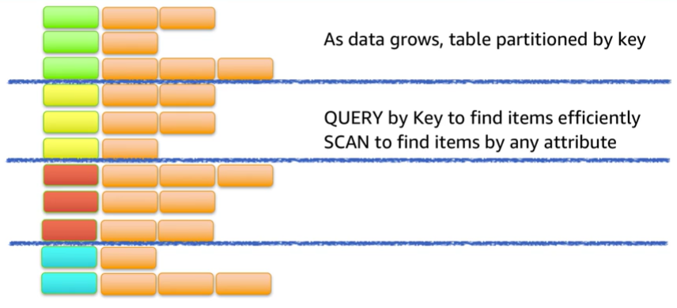
Partitioning
Notes:
As data grows, table data is partitioned and indexed by the primary key.
You can retrieve data from a DynamoDB table in two different ways:
In the first method, the query operation takes advantage of partitioning to effectively locate items by using the primary key.
The second method is via a scan, which enables you to locate items in the table by matching conditions on non-key attributes. The second method gives you the flexibility to locate items by other attributes. However, the operation is less efficient because DynamoDB will scan through all the items in the table to find the ones that match your criteria.
For accessibility: Partitioning allows large tables to be scanned and queried quickly. As data grows, table is partitioned by key. QUERY by Key to find items by any attribute. End of accessibility description.

Slide 68
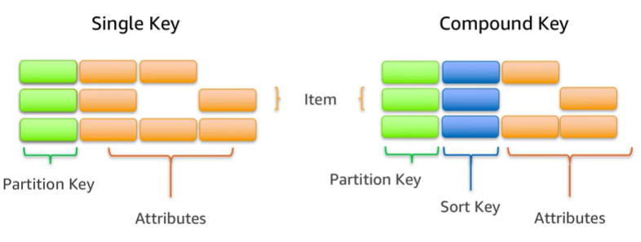
Items in a table must have a key
Notes:
To take full advantage of query operations and DynamoDB, it's important to think about the key that you use to uniquely identify items in the DynamoDB table. You can set up a simple primary key that is based on a single attribute of the data values with a uniform distribution, such as the Globally Unique Identifier (GUID) or other random identifiers.
For example, if you wanted to model a table with products, you could use some attributes like the product ID. Alternatively, you can specify a compound key, which is composed of a partition key and a secondary key. In this example, if you had a table with books, you might use the combination of author and title to uniquely identify table items. This method could be useful if you expect to frequently look at books by author because you could then use query.
For accessibility: The two different types of keys. A single key means the data is identified by an item in the data that uniquely identifies each record. A compound key is made up of a partition key and a second key that can be used for sorting data. End of accessibility description.

Slide 69
Section 2 key takeaways
Amazon DynamoDB:
Runs exclusively on SSDs.
Supports document and key-value store models.
Replicates your tables automatically across your choice of AWS Regions.
Works well for mobile, web, gaming, adtech, and Internet of Things (IoT) applications.
Is accessible via the console, the AWS CLI, and API calls.
Provides consistent, single-digit millisecond latency at any scale.
Has no limits on table size or throughput.
Notes:
DynamoDB runs exclusively on SSDs, and it supports document and key-value store models.
DynamoDB works well for mobile, web, gaming, ad tech, and Internet of Things (IoT) applications.
It’s accessible via the console, the AWS CLI, and API calls.
The ability to scale your tables in terms of both storage and provision throughput makes DynamoDB a good fit for structured data from the web, mobile, and IoT applications. For instance, you might have a large number of clients that continuously generate data and make large numbers of requests per second. In this case, the throughput scaling of DynamoDB enables consistent performance for your clients. DynamoDB is also used in latency-sensitive applications. The predictable query performance—even in large tables—makes it useful for cases where variable latency could cause significant impact to the user experience or to business goals, such as adtech or gaming.
The DynamoDB Global Tables feature reduces the work of replicating data between Regions and resolving update conflicts. It replicates your DynamoDB tables automatically across your choice of AWS Regions. Global Tables can help applications stay available and performant for business continuity.

Slide 70
Section 3: Amazon Redshift
Module 8: Databases
Notes:
Welcome to Section 3: Amazon Redshift.

Slide 71

Amazon Redshift
Amazon Redshift
Notes:
Amazon Redshift is a fast, fully managed data warehouse that makes it simple and cost-effective to analyze all your data by using standard SQL and your existing business intelligence (BI) tools. Here is a look at Amazon Redshift and how you can use it for analytic applications.

Slide 72
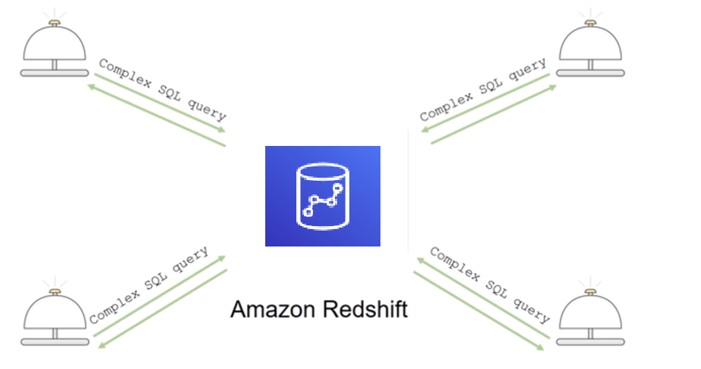
Introduction to Amazon Redshift
Notes:
Analytics is important for businesses today, but building a data warehouse is complex and expensive. Data warehouses can take months and significant financial resources to set up.
Amazon Redshift is a fast and powerful, fully managed data warehouse that is simple and cost-effective to set up, use, and scale. It enables you to run complex analytic queries against petabytes of structured data by using sophisticated query optimization, columnar storage on high-performance local disks, and massively parallel data processing. Most results come back in seconds.
You will next review a slightly more detailed exploration of key Amazon Redshift features and some common use cases.

Slide 73

Parallel processing architecture
SQL Clients/BI tools
Amazon Redshift
Leader node
Dense compute
node
Dense compute nodes
Virtual Core
RAM
Local disk
Amazon DynamoDB
Amazon S3
Notes:
The leader node manages communications with client programs and all communication with compute nodes. It parses and develops plans to carry out database operations—specifically, the series of steps that are needed to obtain results for complex queries. The leader node compiles code for individual elements of the plan and assigns the code to individual compute nodes. The compute nodes run the compiled code and send intermediate results back to the leader node for final aggregation.
Like other AWS services, you only pay for what you use. You can get started for as little as 25 cents per hour and, at scale, Amazon Redshift can deliver storage and processing for approximately $1,000 dollars per terabyte per year (with 3-Year Partial Upfront Reserved Instance pricing).
The Amazon Redshift Spectrum feature enables you to run queries against exabytes of data directly in Amazon S3.

Slide 74
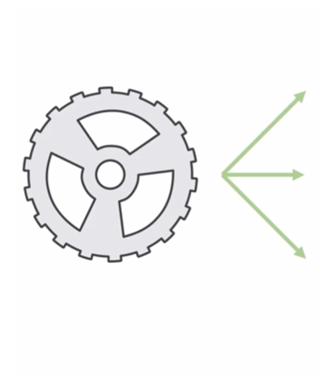

Automation and scaling
Manage
Monitor
Scale
Notes:
It is straightforward to automate most of the common administrative tasks to manage, monitor, and scale your Amazon Redshift cluster—which enables you to focus on your data and your business.
Scalability is intrinsic in Amazon Redshift. Your cluster can be scaled up and down as your needs change with a few clicks in the console.
Security is the highest priority for AWS. With Amazon Redshift, security is built in, and it is designed to provide strong encryption of your data both at rest and in transit.

Slide 75
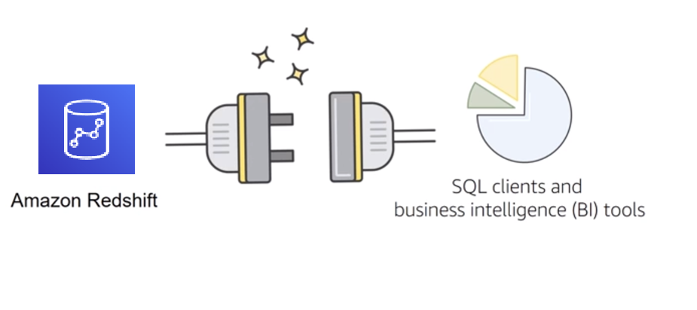
Compatibility
Notes:
Finally, Amazon Redshift is compatible with the tools that you already know and use. Amazon Redshift supports standard SQL. It also provides high-performance Java Database Connectivity (JDBC) and Open Database Connectivity (ODBC) connectors, which enable you to use the SQL clients and BI tools of your choice.
Next, you will review some common Amazon Redshift use cases.

Slide 76

Amazon Redshift use cases (1 of 2)
Enterprise data warehouse (EDW)
Migrate at a pace that customers are comfortable with
Experiment without large upfront cost or commitment
Respond faster to business needs
Big data
Low price point for small customers
Managed service for ease of deployment and maintenance
Focus more on data and less on database management
Notes:
This slide discusses some Amazon Redshift use cases.
Many customers migrate their traditional enterprise data warehouses to Amazon Redshift with the primary goal of agility. Customers can start at whatever scale they want and experiment with their data without needing to rely on complicated processes with their IT departments to procure and prepare their software.
Big data customers have one thing in common: massive amounts of data that stretch their existing systems to a breaking point. Smaller customers might not have the resources to procure the hardware and expertise that is needed to run these systems. With Amazon Redshift, smaller customers can quickly set up and use a data warehouse at a comparatively low price point.
As a managed service, Amazon Redshift handles many of the deployment and ongoing maintenance tasks that often require a database administrator. This enables customers to focus on querying and analyzing their data.

Slide 77

Amazon Redshift use cases (2 of 2)
Software as a service (SaaS)
Scale the data warehouse capacity as demand grows
Add analytic functionality to applications
Reduce hardware and software costs
Notes:
Software as a service (SaaS) customers can take advantage of the scalable, easy-to-manage features that Amazon Redshift provides. Some customers use the Amazon Redshift to provide analytic capabilities to their applications. Some users deploy a cluster per customer, and use tagging to simplify and manage their service level agreements (SLAs) and billing. Amazon Redshift can help you reduce hardware and software costs.

Slide 78
Section 3 key takeaways
Amazon Redshift features:
Fast, fully managed data warehouse service
Easily scale with no downtime
Columnar storage and parallel processing architectures
Automatically and continuously monitors cluster
Encryption is built in
Notes:
In summary, Amazon Redshift is a fast, fully managed data warehouse service. As a business grows, you can easily scale with no downtime by adding more nodes. Amazon Redshift automatically adds the nodes to your cluster and redistributes the data for maximum performance.
Amazon Redshift is designed to consistently deliver high performance. Amazon Redshift uses columnar storage and a massively parallel processing architecture. These features parallelize and distribute data and queries across multiple nodes. Amazon Redshift also automatically monitors your cluster and backs up your data so that you can easily restore if needed. Encryption is built in—you only need to enable it.
To learn more about Amazon Redshift, see https://aws.amazon.com/redshift/.

Slide 79
Section 4: Amazon Aurora
Module 8: Databases
Notes:
Introducing Section 4: Amazon Aurora.

Slide 80

Amazon Aurora
Enterprise-class relational database
Compatible with MySQL or PostgreSQL
Automate time-consuming tasks (such as provisioning, patching, backup, recovery, failure detection, and repair).
Amazon Aurora
Notes:
Amazon Aurora is a MySQL- and PostgreSQL-compatible relational database that is built for the cloud. It combines the performance and availability of high-end commercial databases with the simplicity and cost-effectiveness of open-source databases. Using Amazon Aurora can reduce your database costs while improving the reliability and availability of the database. As a fully managed service, Aurora is designed to automate time-consuming tasks like provisioning, patching, backup, recovery, failure detection, and repair.

Slide 81
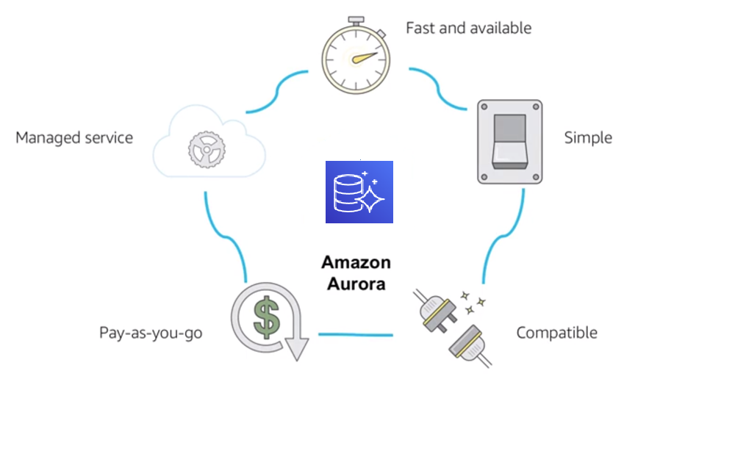
Amazon Aurora service benefits
Notes:
This slide covers some of the benefits of Amazon Aurora. It is highly available and it offers a fast, distributed storage subsystem. Amazon Aurora is straightforward to set up and uses SQL queries. It is designed to have drop-in compatibility with MySQL and PostgreSQL database engines so that you can use most of your existing database tools with little or no change.
Amazon Aurora is a pay-as-you-go service, which means that you only pay for the services and features that you use. It’s a managed service that integrates with features such as AWS Database Migration Service (AWS DMS) and the AWS Schema Conversion Tool. These features are designed to help you move your dataset into Amazon Aurora.

Slide 82
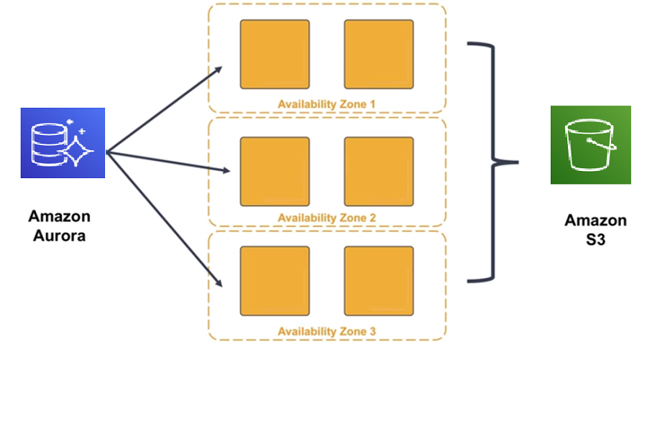
High availability
Notes:
Why might you use Amazon Aurora over other options, like SQL with Amazon RDS? Most of that decision involves the high availability and resilient design that Amazon Aurora offers.
Amazon Aurora is designed to be highly available: it stores multiple copies of your data across multiple Availability Zones with continuous backups to Amazon S3. Amazon Aurora can use up to 15 read replicas can be used to reduce the possibility of losing your data. Additionally, Amazon Aurora is designed for instant crash recovery if your primary database becomes unhealthy.

Slide 83
Section 4 key takeaways
Amazon Aurora features:
High performance and scalability
High availability and durability
Multiple levels of security
Compatible with MySQL and PostgreSQL
Fully managed
Notes:
In summary, Amazon Aurora is a highly available, performant, and cost-effective managed relational database.
Aurora offers a distributed, high-performance storage subsystem. Using Amazon Aurora can reduce your database costs while improving the reliability of the database.
Aurora is also designed to be highly available. It has fault-tolerant and self-healing storage built for the cloud. Aurora replicates multiple copies of your data across multiple Availability Zones, and it continuously backs up your data to Amazon S3.
Multiple levels of security are available, including network isolation by using Amazon VPC; encryption at rest by using keys that you create and control through AWS Key Management Service (AWS KMS); and encryption of data in transit by using Secure Sockets Layer (SSL).
The Amazon Aurora database engine is compatible with existing MySQL and PostgreSQL open source databases, and adds compatibility for new releases regularly.
Finally, Amazon Aurora is fully managed by Amazon RDS. Aurora automates database management tasks, such as hardware provisioning, software patching, setup, configuration, or backups.
To learn more about Amazon Aurora, see https://aws.amazon.com/rds/aurora/.

Slide 84
The right tool for the right job
What are my requirements?
Enterprise-class relational database | Amazon RDS
Fast and flexible NoSQL database service for any scale | Amazon DynamoDB
Operating system access or application features that are not supported by AWS database services | Databases on Amazon EC2
Specific case-driven requirements (machine learning, data warehouse, graphs) | AWS purpose-built database services
Notes:
As you saw in this module, the cloud continues to drive down the cost of storage and compute. A new generation of applications has emerged, which created a new set of requirements for databases. These applications need databases to store terabytes to petabytes of new types of data, provide access to the data with millisecond latency, process millions of requests per second, and scale to support millions of users anywhere in the world. To support these requirements, you need both relational and non-relational databases that are purpose-built to handle the specific needs of your applications. AWS offers a broad range of databases that are built for your specific application use cases.

Slide 85
RDS vs. Aurora
Know the difference!
RDS (Relational Database Service)
Managed platform
Several DB engines
Fixed storage allocation
Decent availability
Aurora
Custom AWS DB Engine
MySQL or PostgreSQL only
Auto-scaling storage
Built-in high availability "4 9s"
Cost: Lower, with tradeoffs
Cost: Higher, due to conveniences

Slide 86
Module wrap-up
Module 8: Databases
Notes:
It’s now time to review the module, and wrap up with a knowledge check and discussion of a practice certification exam question.

Slide 87
Module summary
In summary, in this module, you learned how to:
Explain Amazon Relational Database Service (Amazon RDS)
Identify the functionality in Amazon RDS
Explain Amazon DynamoDB
Identify the functionality in Amazon DynamoDB
Explain Amazon Redshift
Explain Amazon Aurora
Perform tasks in an RDS database, such as launching, configuring, and interacting
Notes:
In summary, in this module, you learn how to:
Explain Amazon Relational Database Service (Amazon RDS)
Identify the functionality in Amazon RDS
Explain Amazon DynamoDB
Identify the functionality in Amazon DynamoDB
Explain Amazon Redshift
Explain Amazon Aurora
Perform tasks in an RDS database, such as launching, configuring, and interacting

Slide 88
Thank you
All trademarks are the property of their owners.
Notes:
Thank you for completing this module.

